Slide 1






SALARY PREDICTIONS OF DATA PROFESSIONS
Fiaz ul Hasan

Slide 2




INTRODUCTION:
Problem Statement:
This internship project focuses on leveraging machine learning classification techniques to develop an
effective fraud detection system for Fastag transactions. The dataset comprises key features such as ransaction details, vehicle information, geographical location, and transaction amounts. The goal is to
create a robust model that can accurately identify instances of fraudulent activity, ensuring the integrity
and security of Fastag transactions.

Slide 3




Data Overview
Data Visualization
Mention the total number of records and features in the dataset.
Display the first few rows of the dataset to give a glimpse of the data.
Highlight any missing values and duplicate rows, along with their treatment
Show a histogram of the salary distribution to understand its spread.
Describe any insights regarding salary distribution (e.g., skewness, outliers).
Show scatter plots, box plots, and bar plots depicting salary variations with age, gender, and performance ratings.

Slide 4




Model Selection
Model Training and Evaluation
Introduce the machine learning models chosen for fastag Frud Detection (Logistic Regression, Decision Tree, Random Forest, SVM) explain each model and its suitability for the problem.
Python script that evaluates multiple machine learning models for fraud detection in Fastag transactions and displays the results in a styled DataFrame.
The DataFrame includes metrics such as accuracy, precision, recall, and F1 score for both the training and testing phases. The styled_results DataFrame is styled for better visualization.

Slide 5


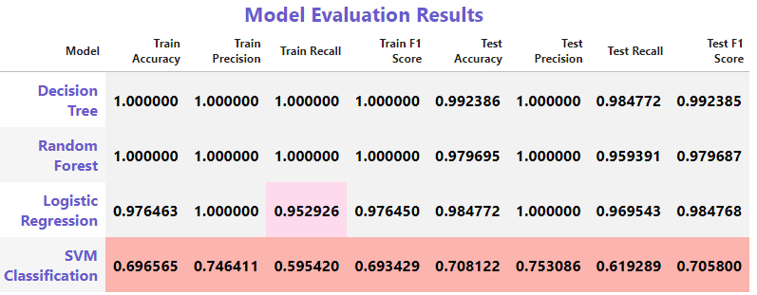



Model Performance Comparison

Slide 6









Thank You

